Slide 1
Modeling Spread of an infectious diseases
Jason Mejia
5/5/2021
Senior Design

Slide 2
Objective
SIR Modeling
Why is SIR used for infectious diseases?
Review the outcomes of the model involving
Lockdowns
SEIR Model
Mortality Rates

Slide 3
SIR Modeling
The SIR model is one of the simplest compartmental models, and many models are derivatives of this basic form. The model consists of three compartments:-
S: The number of susceptible individuals. The susceptible individual contracts the disease
I: The number of infectious individuals. Capable of infecting susceptible individuals.
R: for the number of removed or deceased individuals. Have either recovered from the disease and entered removed compartment or died.
Why is SIR used?
This can be applied to assess the spread of the disease and predict the number of infected, removed and recovered populations and deaths in the communities, accommodating at the same time possible surges in the number of susceptible individuals

Slide 4

Equations for SIR model
N: total population
S(t): number of people susceptible on day t
I(t): number of people infected on day t
R(t): number of people recovered on day t
β: expected amount of people an infected person infects per day
D: number of days an infected person has and can spread the disease
γ: the proportion of infected recovering per day (γ = 1/D)

Slide 5
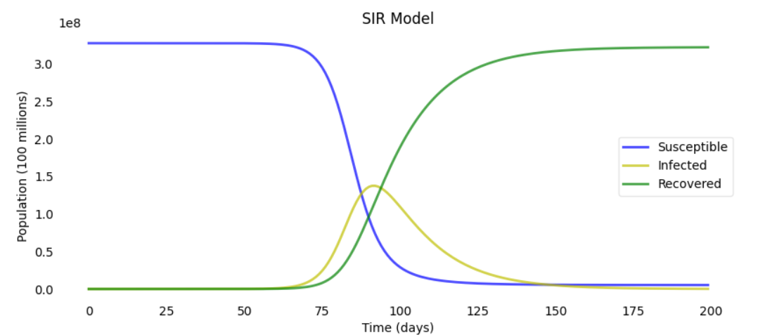
Graph of SIR
Input:
N = 328,000,000 # population
beta = 0.3 # infected person infects
D = 14.0 # infections lasts
gamma = 1.0 / D # proportion of infected recovering per day

Slide 6
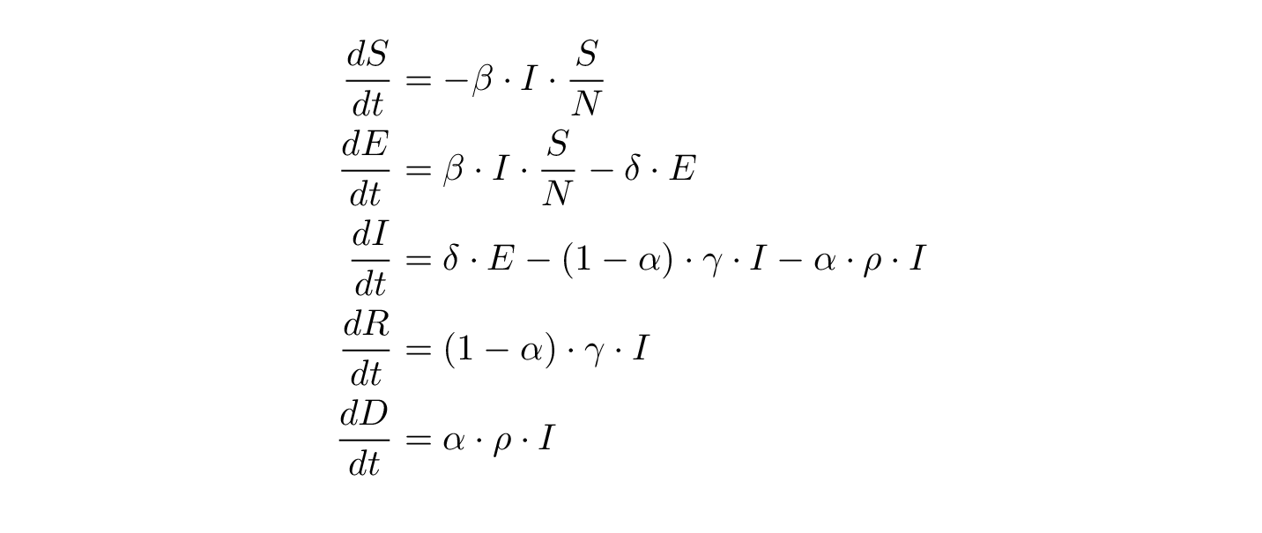
Equations for SEIR model
N: total population
S(t): number of people susceptible on day t
I(t): number of people infected on day t
R(t): number of people recovered on day t
β: expected amount of people an infected person infects per day
D: number of days an infected person has and can spread the disease
γ: the proportion of infected recovering per day (γ = 1/D)
δ: length of incubation period
α: fatality rate
ρ: rate at which people die (= 1/days from infected until death)

Slide 7
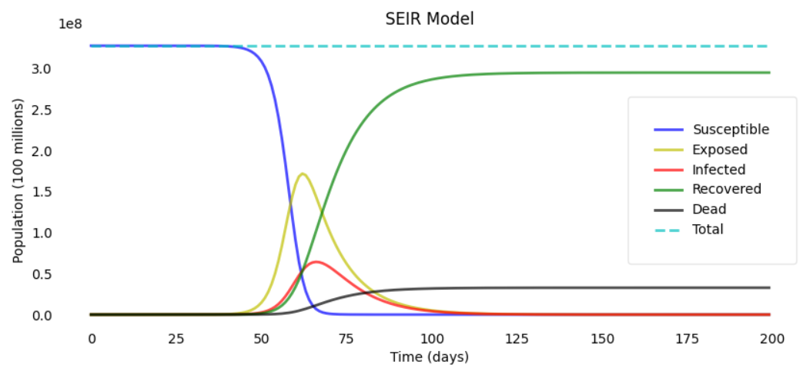
Graphs of SEIR Model
Input:
N = 328,000,000 # population
D = 4.0 # infections lasts
gamma = 1.0 / D # proportion of infected recovering per day
delta = 1.0 / 4 # incubation period
R_0 = 10.0 # total number of people an infected person can infect
beta = R_0 * gamma # infected person infects per day
alpha = 0.2 # 20% death rate
rho = 1/9 # days from infection until death

Slide 8
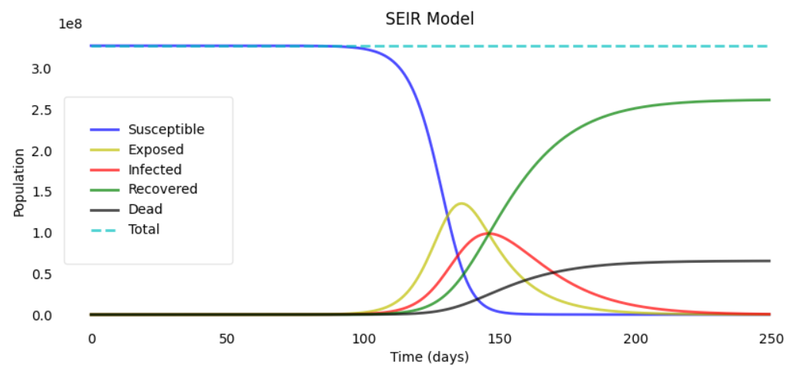
Graphs of SEIR Model
Input:
N = 328,000,000 # population
D = 14.0 # infections lasts
gamma = 1.0 / D # proportion of infected recovering per day
delta = 1.0 / 14.0# incubation period
R_0 = 5.0 # total number of people an infected person can infect
beta = R_0 * gamma # infected person infects per day
alpha = 0.2 # 20% death rate
rho = 1/20 # days from infection until death

Slide 9

Equation for SEIR model with Mortality Rate
α_OPT: is the optimal fatality rate. For example, if s=1 and half the population is infected on one day, then s ⋅ I(t) / N = 1/2, so the fatality rate α(t) on that day is 50% + α_OPT

Slide 10
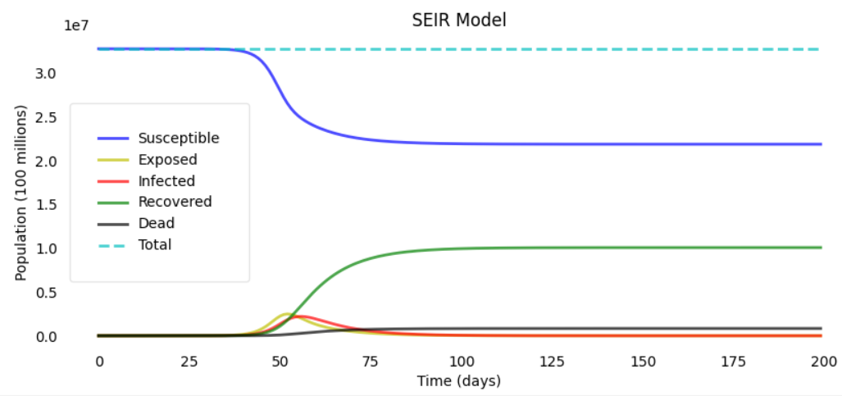
Graphs of SEIR Model with mortality rate (Older age group)
Input:
N = 328,000,000 # population
D = 14.0 # infections lasts
gamma = 1.0 / D # proportion of infected recovering per day
delta = 1.0/14.0# incubation period
rho = 1/20 # days from infection until death
proportion_of_ agegroup = { "0-29": 0.1, "30-59": 0.2, "60-89": 0.3, "89+": 0.4}

Slide 11
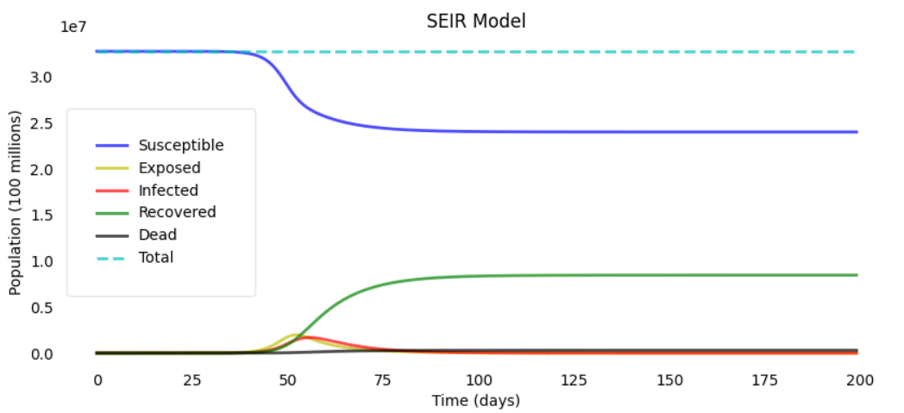
Graphs of SEIR Model with mortality rate (younger age group)
Input:
N = 328,000,000 # population
D = 14.0 # infections lasts
gamma = 1.0 / D # proportion of infected recovering per day
delta = 1.0/14.0 # incubation period
rho = 1/20 # days from infection until death
proportion_of_ agegroup = { "0-29": 0.4, "30-59": 0.4, "60-89": 0.1, "89+": 0.1}

Slide 12

Equations for SEIR model with Lockdowns
R_{0start} and R_{0end} : are the values of R₀ on the first and the last day
X₀: is the x-value of the inflection point (i.e. the date of the steepest decline in R₀ , this could be thought of as the main “lockdown” date)
K: lets us vary how quickly R₀ declines

Slide 13
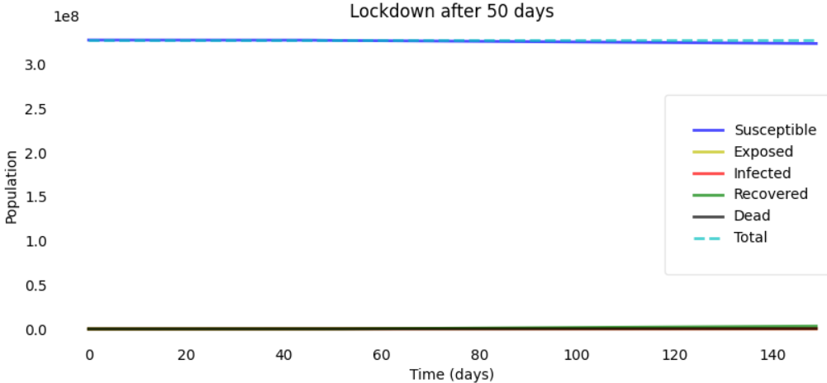
Graphs of the Lockdown
Input:
L = 50 # days
N = 328,000,000 # population
D = 14.0 # infections lasts
gamma = 1.0 / D # proportion of infected recovering per day
delta = 1.0/14.0 # incubation period
alpha = 0.2 # 20% death rate
rho = 1/20 # days from infection until death

Slide 14
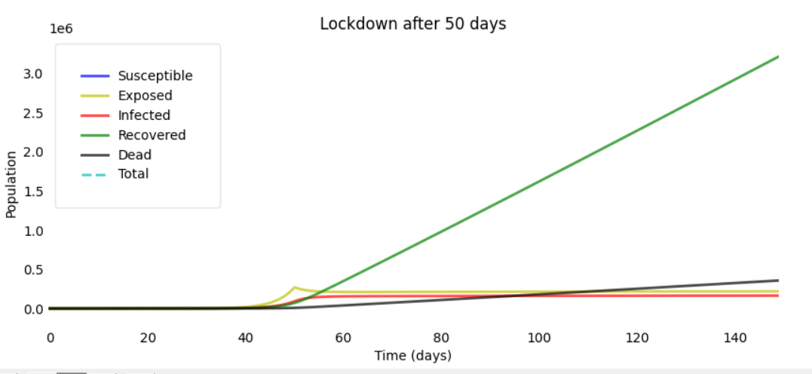
Graphs of the Lockdown
Input:
L = 50 # days
N = 328,000,000 # population
D = 14.0 # infections lasts
gamma = 1.0 / D # proportion of infected recovering per day
delta = 1.0/14.0 # incubation period
alpha = 0.2 # 20% death rate
rho = 1/20 # days from infection until death

Slide 15
Conclusion
Have discovered the effectiveness of using the SIR model
I have learned to model SIR/SEIR models to find estimates of epidemic outcomes
How to modify the SIR models to input categories I would like to see affected, for example: lockdowns, mortality rate by age.

